Slide 1



MANAGERIAL
OBJECTIVES

Slide 2

CASE STUDY
Ramachadran, an employee in a telecommunications firm, is always late to work. He has been reminded by his manager to be punctual several times. One day the Managing director walks in early and notes that Ramachandran is late, calls for the muster and observes that he is regularly irregular. He calls for the manager and asks him why action has not been taken in this regard. The manager replies that he has told Ramachandra several times but no proof of his reminders.
What should the manager have done?
What was the communication gap that led to laxity in Ramchandran’s behaviour?

Slide 3

Major objectives of a company
Optimal Utilization of Resources
Enhance shareholders returns
Increase market share
Provide Quality to customers
Adapt and Adjust
Resources
Market share
Shareholders return
Quality to Customers
Adapt & Adjust

Slide 4
Specific objectives of a company
Increase Prouctivity by a specific percentage
Improving specific attributes
Reduction in specific costs

Slide 5


CORPORATE SOCIAL RESPONSIBITY

Slide 6



Slide 7


Lijjat Papad: A Case Study in Corporate Social Responsibility (CSR)
Background
Lijjat Papad, a renowned Indian cooperative,
started in 1959 with a modest loan of INR 80.
The organization has grown into a multi-million dollar enterprise, producing a variety of products including papads, spices, and other food items.
Lijjat Papad is not only known for its products but also
for its unique business model and commitment to social responsibility.

Slide 8
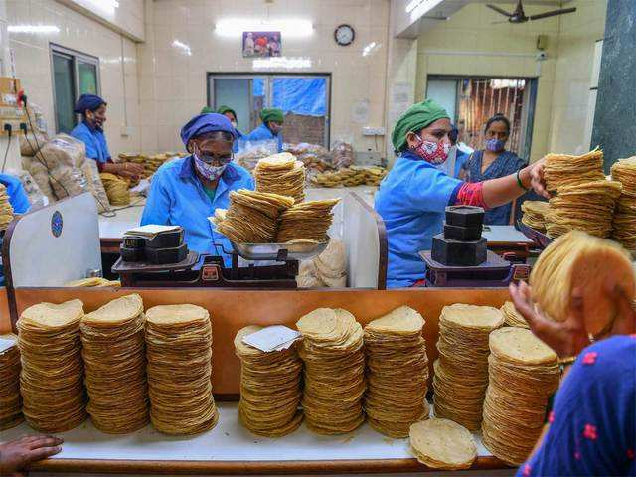
Lijjat Papad: A Case Study in Corporate Social Responsibility (CSR)
Business Model
The business model of Lijjat Papad is based on cooperative principles. It is entirely owned and managed by women. The organization empowers women by providing them with employment opportunities, enabling them to contribute to their household income while maintaining their roles as homemakers. Especially every worker is a shareholder of the company. This model has successfully provided financial independence to thousands of women across India.

Slide 9
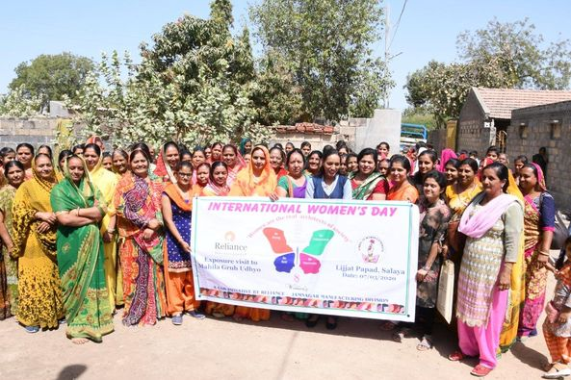
Lijjat Papad: A Case Study in Corporate Social Responsibility (CSR)
CSR Initiatives
Women Empowerment:
Employment: Lijjat Papad has empowered over 45,000 women across India by providing them with stable employment. The organization prioritizes the welfare of its members, ensuring they receive fair wages and have access to a supportive work environment.
Skill Development: The cooperative focuses on the skill development of its members, offering training programs that enhance their entrepreneurial abilities and efficiency.
Education:
Lijjat Papad supports the education of children of its members. The cooperative provides financial assistance and scholarships to ensure that the children receive quality education, thus breaking the cycle of poverty.

Slide 10
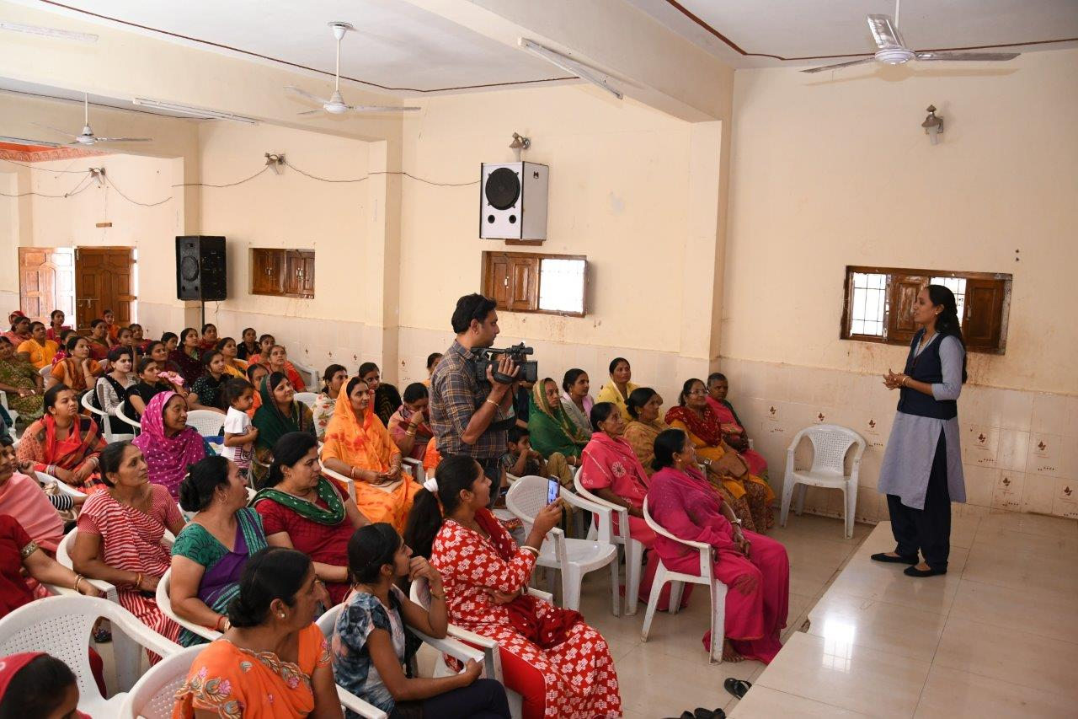
Lijjat Papad: A Case Study in Corporate Social Responsibility (CSR)
3. Health and Well-being:
The organization conducts regular health camps and awareness programs on health and hygiene for its members and their families. These initiatives ensure that the women and their families have access to basic healthcare services.
4. Community Development:
Lijjat Papad is actively involved in community development projects. The cooperative contributes to local infrastructure development, supports environmental sustainability projects, and engages in activities that benefit the broader community.

Slide 11
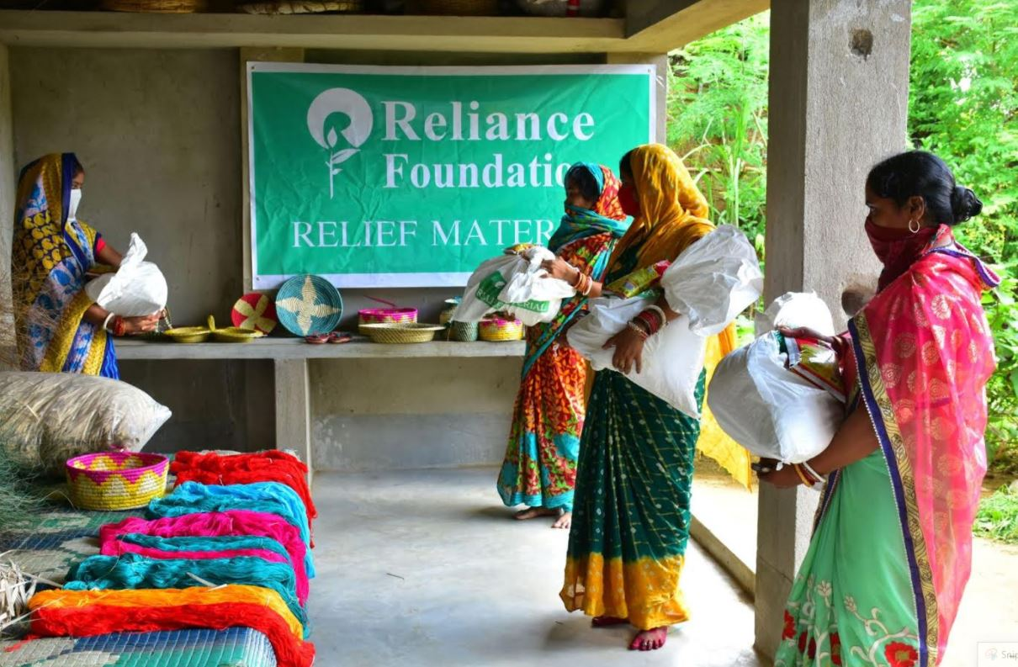
Impact
The CSR initiatives of Lijjat Papad have had a profound impact on the lives of its members and their communities. By providing employment and supporting education and health, the organization has improved the quality of life for thousands of families. Moreover, Lijjat Papad has set an example of how businesses can thrive while contributing positively to society.
Conclusion
Lijjat Papad’s commitment to corporate social responsibility is deeply ingrained in its business model. The cooperative’s focus on women empowerment, education, health, and community development demonstrates that businesses can achieve success while fostering social good. Lijjat Papad continues to inspire other organizations to adopt sustainable and socially responsible practices.

Slide 12

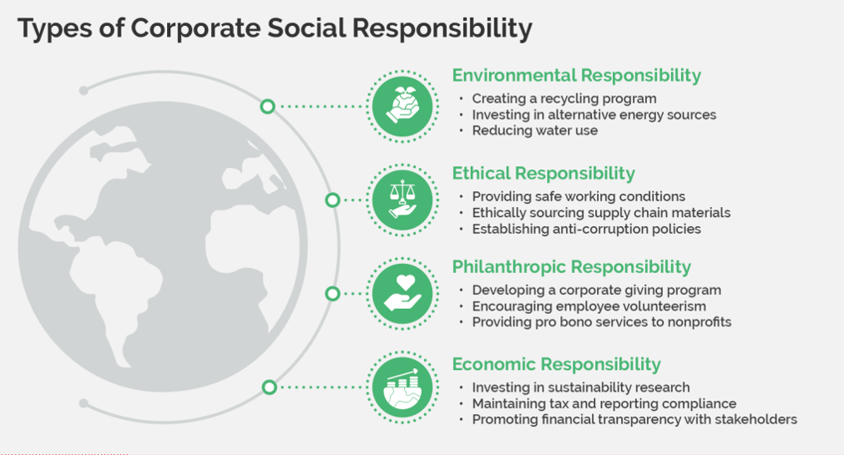

Slide 13

